Slide 1
Description of the Relationship Model
Input
Input
Input
Breakdown of the System into Subsystem
Description of the goal model for the Subsystems
Design Behavior: Activity Model
Design Behavior: Sequence Diagram
Combined Model of the System

Slide 2
Agent
Subsystem Goals
General Goal
Subsystem
Recommendations
Recommender System

Slide 3
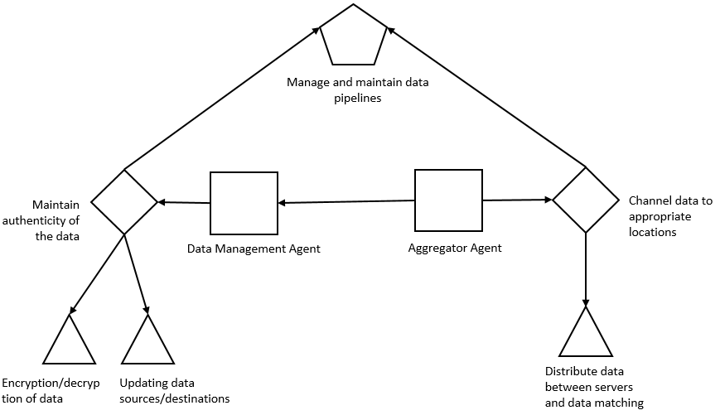
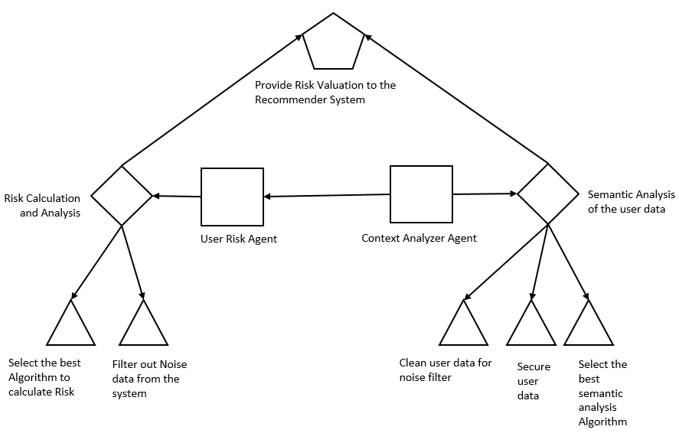
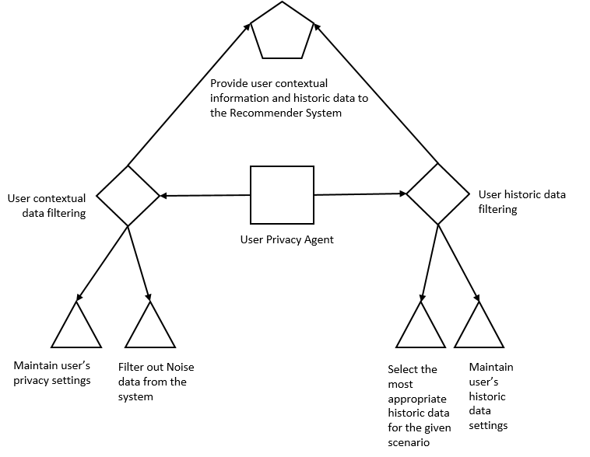
Generate Recommendations
System Objective
Responsibility
Agent
Specific Goals
General Goal

Slide 4
Provide Risk Valuation to the Recommender System
Responsibility
Risk Calculation and Analysis
Semantic Analysis of the user data
Agent
User Risk Agent
Context Analyzer Agent
Specific Goals
Select the best Algorithm to calculate Risk
Filter out Noise data from the system
Clean user data for noise filter
Secure user data
Select the best semantic analysis Algorithm
General Goal

Slide 5
Provide user contextual information and historic data to the Recommender System
Responsibility
User contextual data filtering
User historic data filtering
Agent
User Privacy Agent
Specific Goals
Maintain user’s privacy settings
Filter out Noise data from the system
Select the most appropriate historic data for the given scenario
Maintain user’s historic data settings
General Goal

Slide 6
Manage and maintain data pipelines
Responsibility
Maintain authenticity of the data
Channel data to appropriate locations
Agent
Data Manager Agent
Aggregator Agent
Specific Goals
Encryption/decryption of data
Updating data sources/destinations
Distribute data between servers and data matching
General Goal

Slide 7
Provide Risk Valuation to the Recommender System
Responsibility
Risk Calculation and Analysis
Semantic Analysis of the user data
Agent
User Risk Agent
Context Analyzer Agent
Specific Goals
Calculate contextual Risk using Candidate’s profile information and Employer’s requirements
Filter out any non-relevant information from the system
Extract relevant information from Candidate’s profile and the job description
Select the best semantic analysis Algorithm
General Goal

Slide 8
Provide user contextual information and historic data to the Recommender System
Responsibility
User contextual data filtering
User historic data filtering
Agent
User Privacy Agent
Specific Goals
Maintain Employer’s and User’s privacy settings
Filter out data based on privacy settings of the Candidate/Employer
Select the most appropriate historic data for the given scenario
Maintain Candidate’s and Employer's historic data settings
General Goal

Slide 9
Manage and maintain data pipelines
Responsibility
Maintain authenticity of the data
Channel data to appropriate locations
Agent
Data Management Agent
Aggregator Agent
Specific Goals
Encryption/decryption of the Candidate’s and Employer’s Data
Distribute Candidate’s and Employer’s data between differential privacy server, the computational server and the database
General Goal

Slide 10
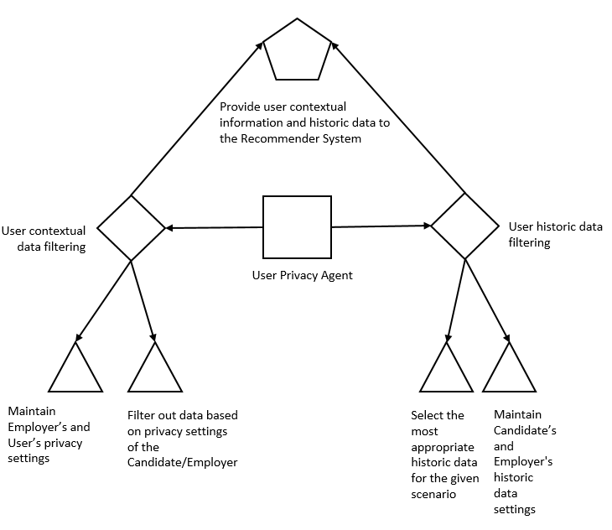
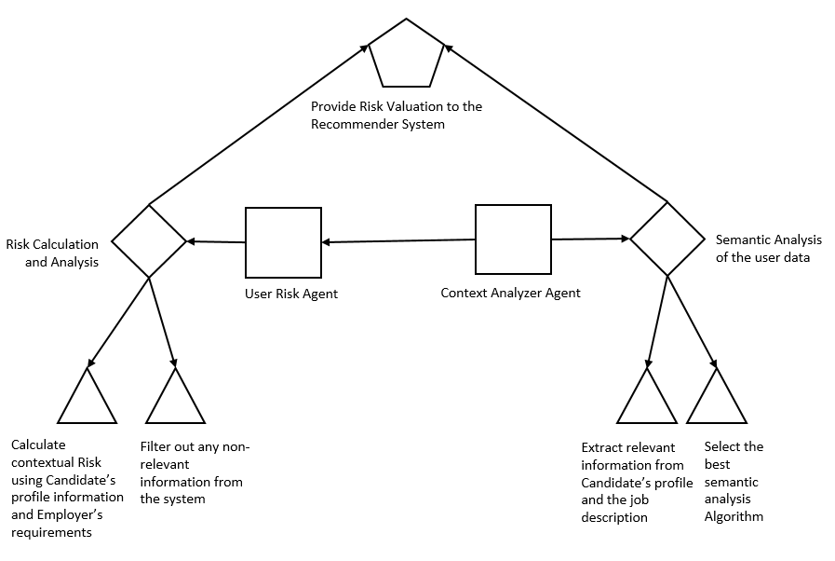
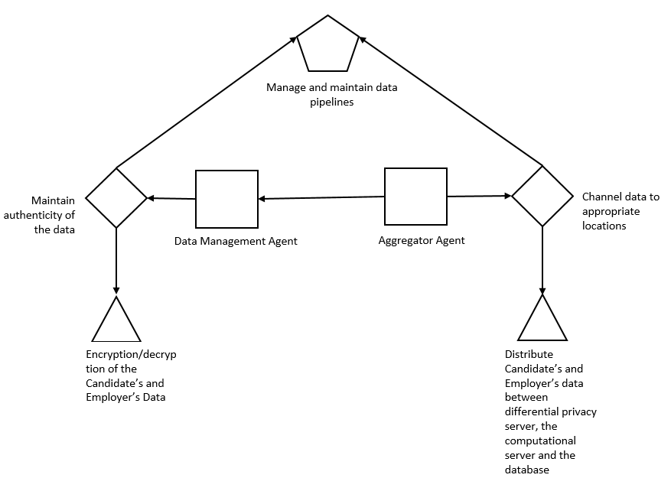
Generate Recommendations
System Objective
Responsibility
Agent
Specific Goals
General Goal

Slide 11
User
Profile
Graph
Content-based Similarity
Important Computation
Interaction
Recommendation

Slide 12
Resume
New Job Postings
Web Crawler
Web Pages
Master DB
Resume Model Builder
Job Model Builder
Preprocess
Tech
Skills
Preprocess
Processor
Job Processor
Degree
Resume Model
Job Model
Query Interface
Job Title
Resume Matcher
Similarity computation
Jobs
Matching Jobs
Job Description

Slide 13
Preprocessing
New Job/Resume Content
Parsing
Semantic Labelling
Pattern Matching
DB
Segmenting
Tokenizing

Slide 14
Final
Model
Subsystem Sequence Diagrams
UML Models
Subsystem Goal Model
Subsystem Activity Model
Breakdown of the System into three Subsystems
System Description
Relationship model for Agents within a Subsystems
Description of Agents within a Subsystem
Multi-Agent System Model

Slide 15
Recommender System
Contextual
Risk
Factors
Data
Privacy
Factors
Algorithm
Recommender Engine

